Slide 1
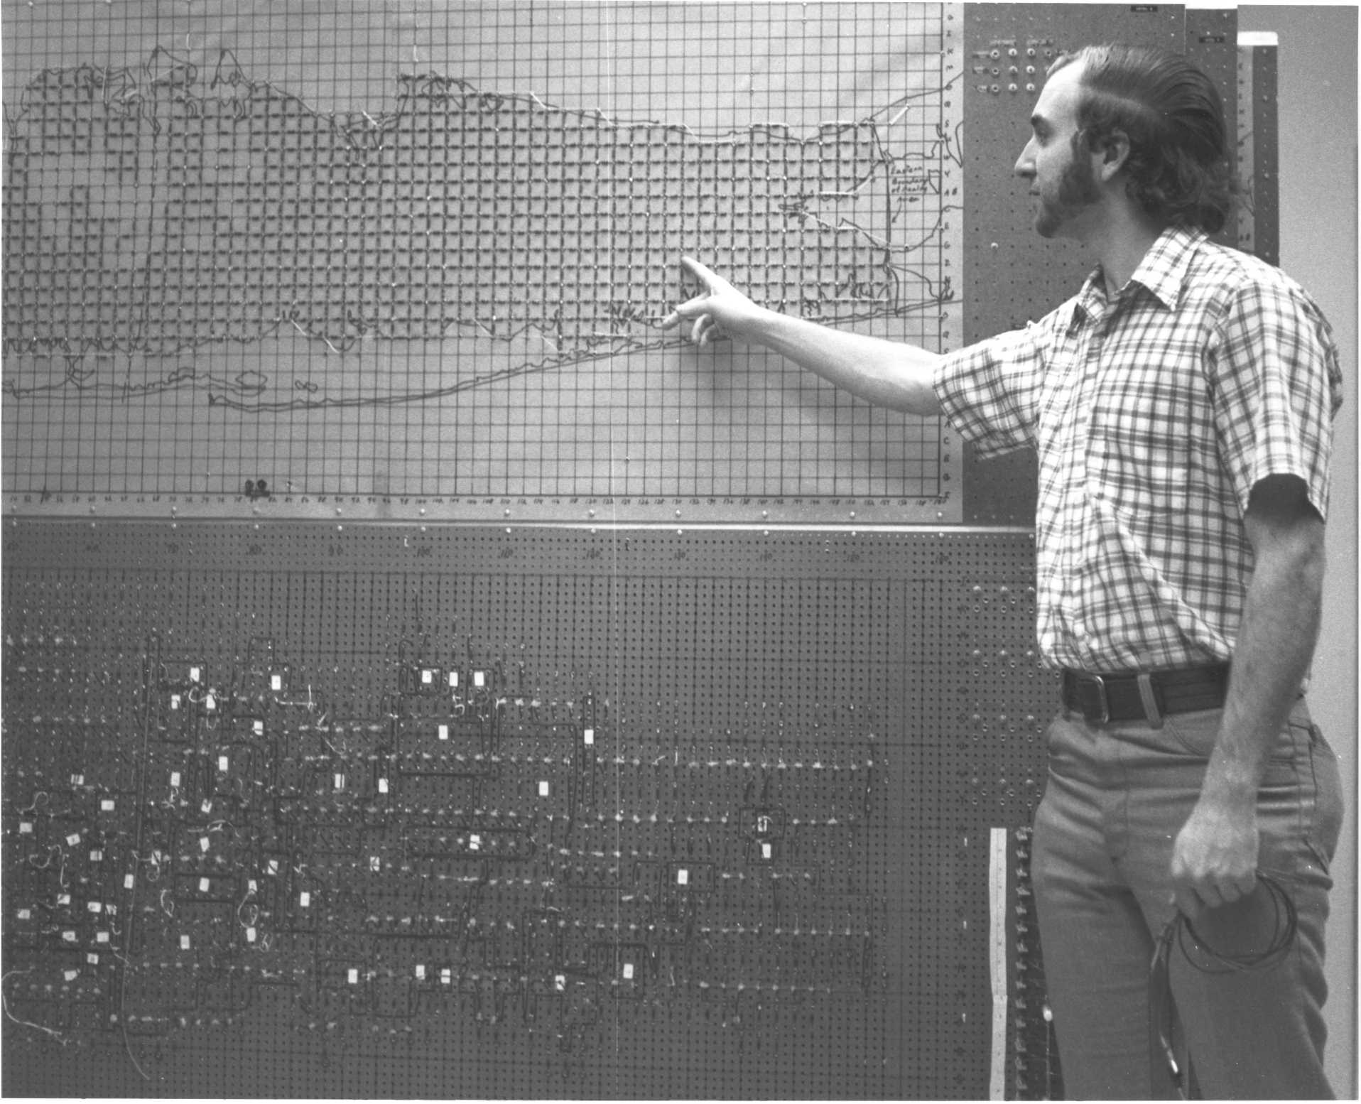
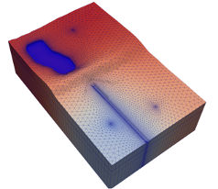
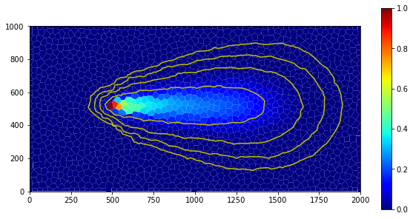



Getting started on USGS supercomputers
Parallel MODFLOW Training Class, July 13-14, 2023, Lakewood, CO

Slide 2
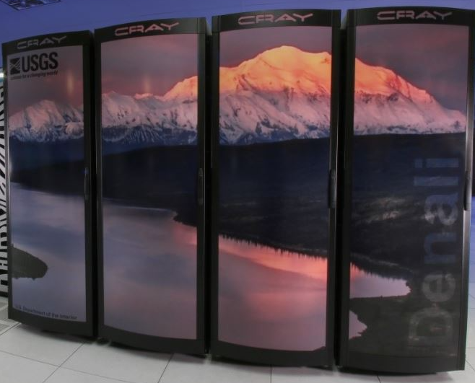
Denali
While on the network or VPN
Open a terminal
Type: ssh username@denali.cr.usgs.gov

Slide 3
Denali
Cray XC-50 Supercomputer
9280 Total CPU cores
2.4 PB Lustre storage 36 GB/s peak I/O
Cray Aries Interconnect (85 Gb/s)
232 compute nodes
Two 20-core 2.4 Ghz Intel Xeon processors
192 GB RAM (4.8 GB/core)
https://hpcportal.cr.usgs.gov/hpc-user-docs/supercomputers/denali.html

Slide 4
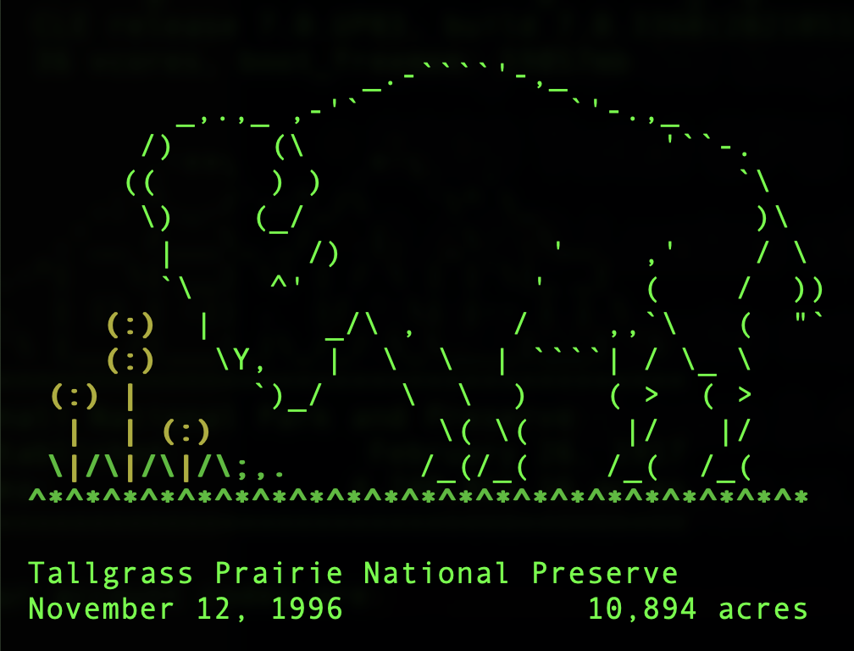
Tallgrass
Cray Urika-CS prototype system
792 CPU cores 122,880 CUDA cores 15,360 Tensor cores
16 Machine Learning Nodes (CPU)
6 Deep Learning Nodes (CPU + GPU)
2 Visualization Nodes
https://hpcportal.cr.usgs.gov/hpc-user-docs/supercomputers/tallgrass.html

Slide 5
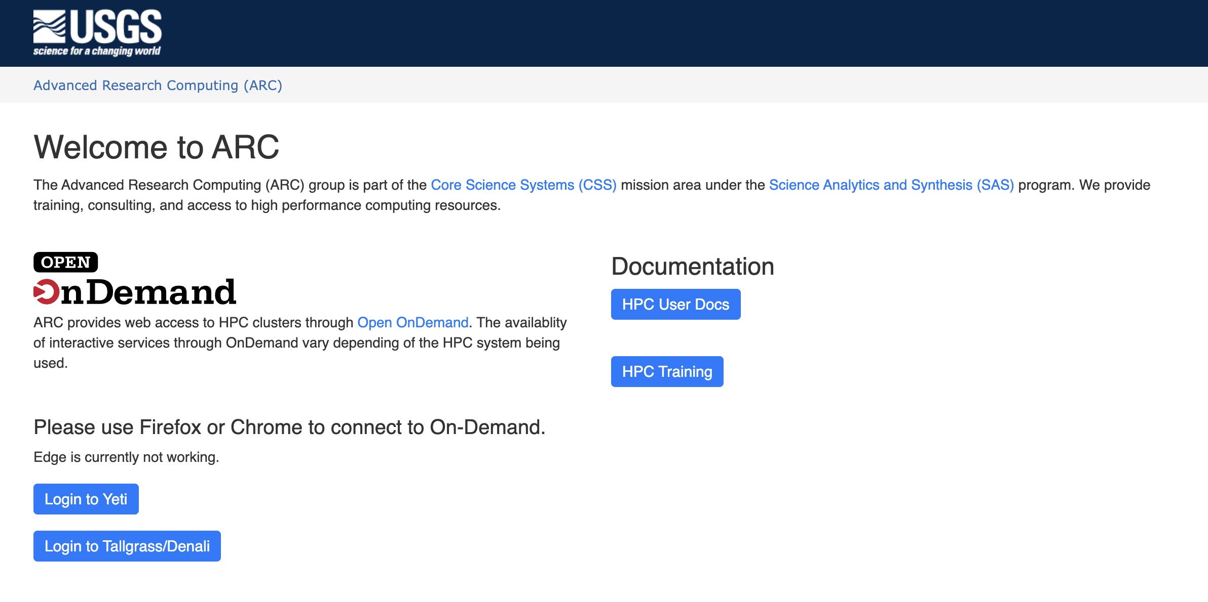
Tallgrass – OnDemand
https://hpcportal.cr.usgs.gov

Slide 6
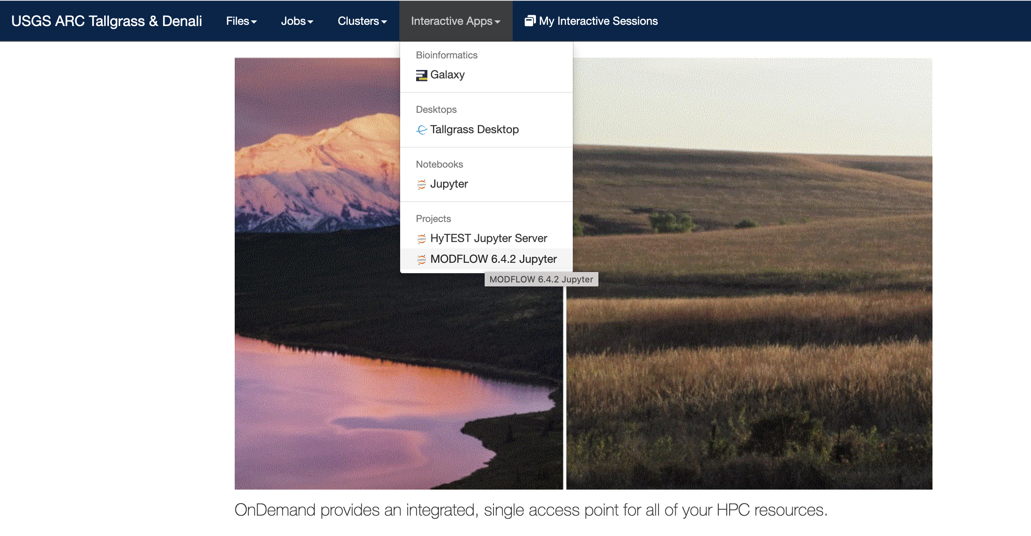
Tallgrass – OnDemand

Slide 7
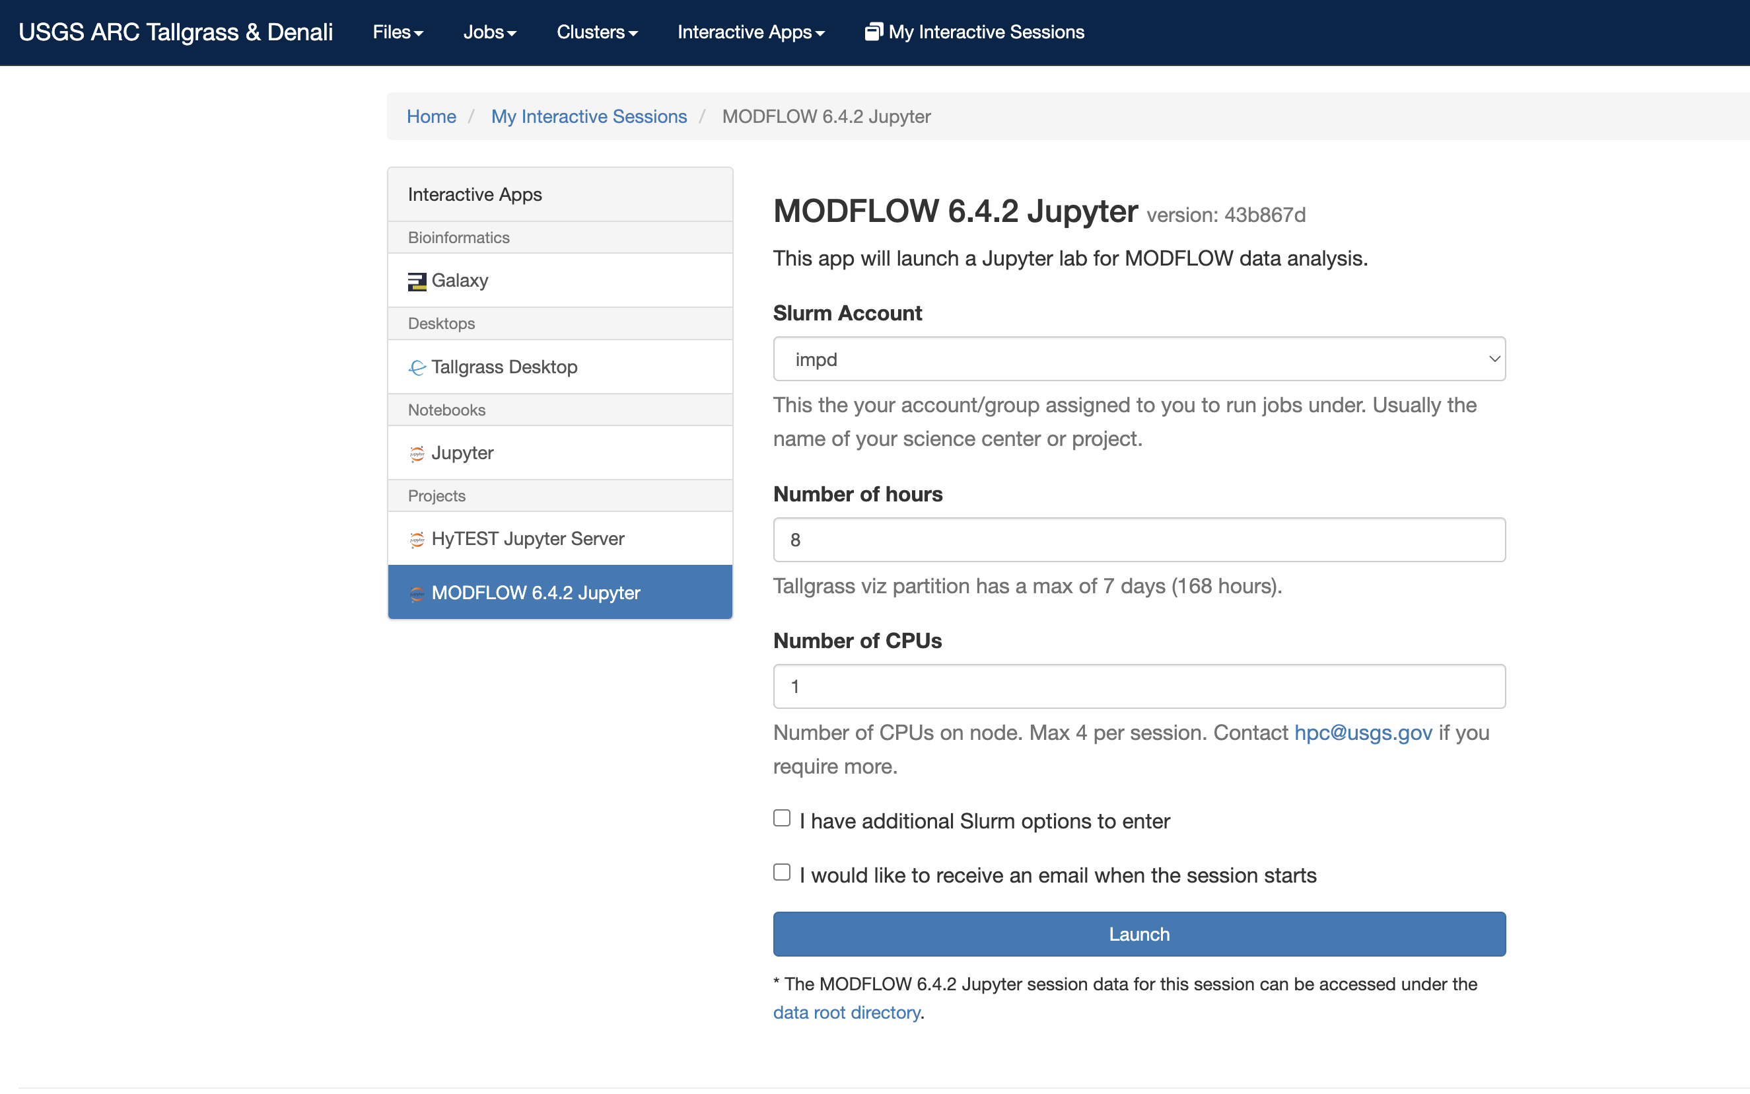
Tallgrass – OnDemand

Slide 8
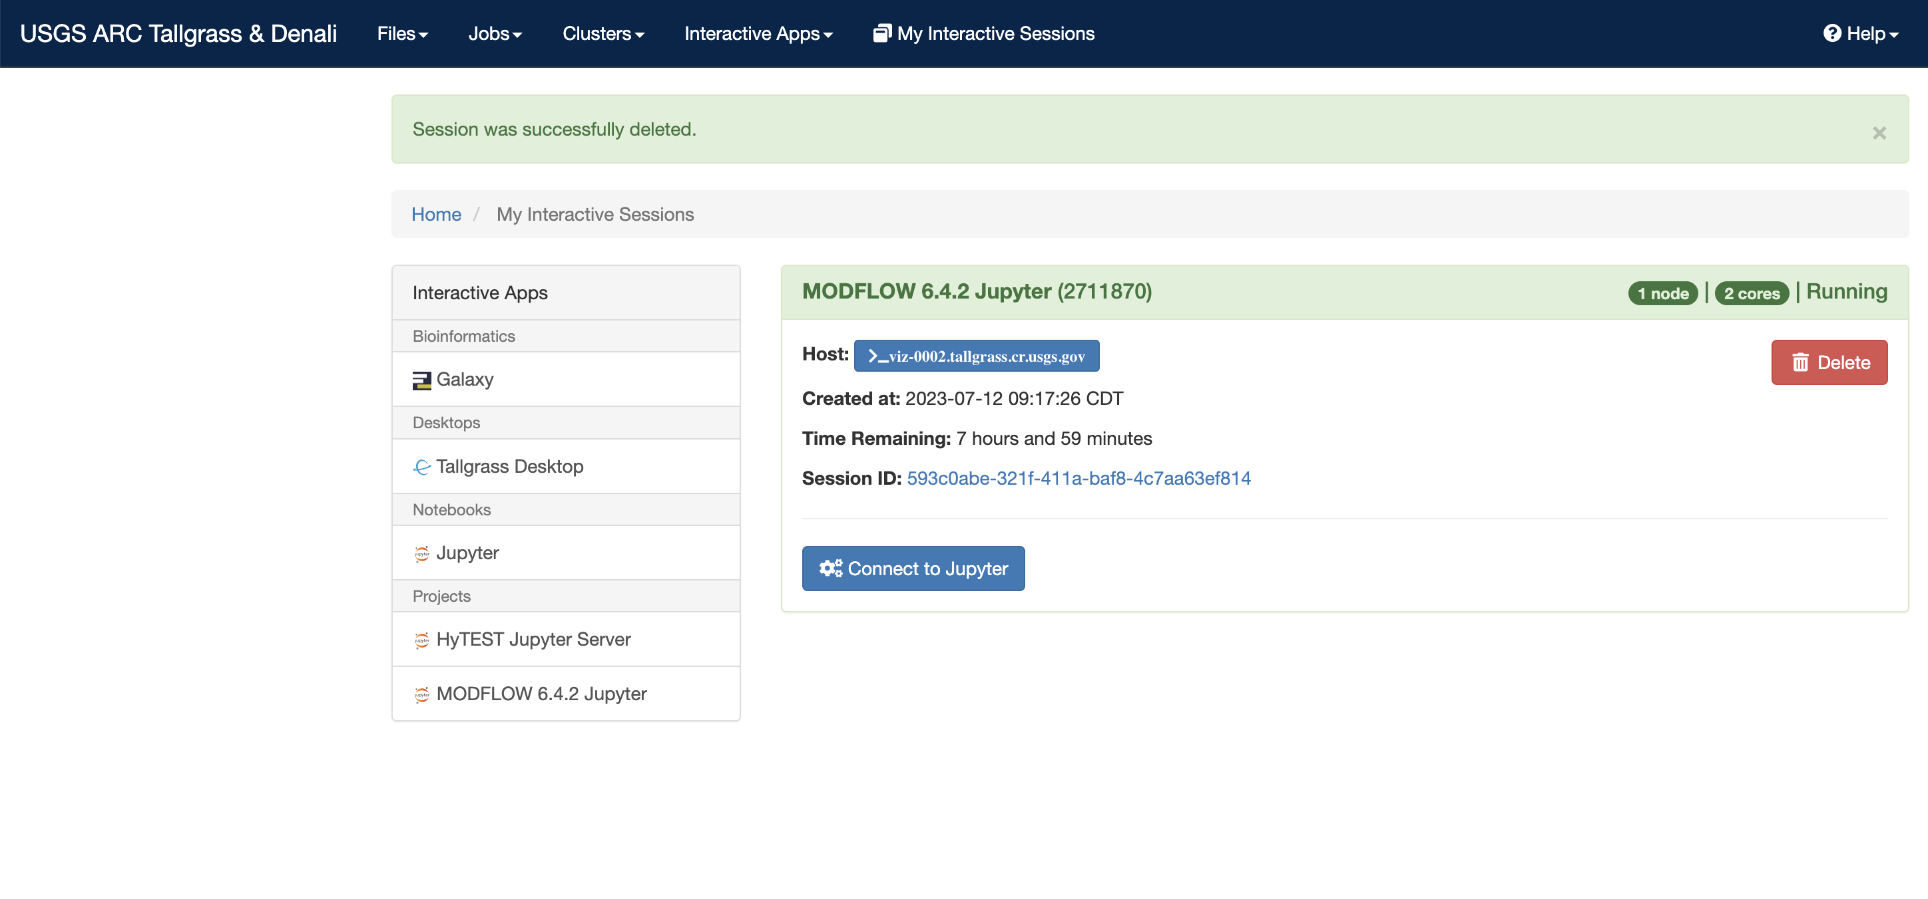
Tallgrass – OnDemand

Slide 9
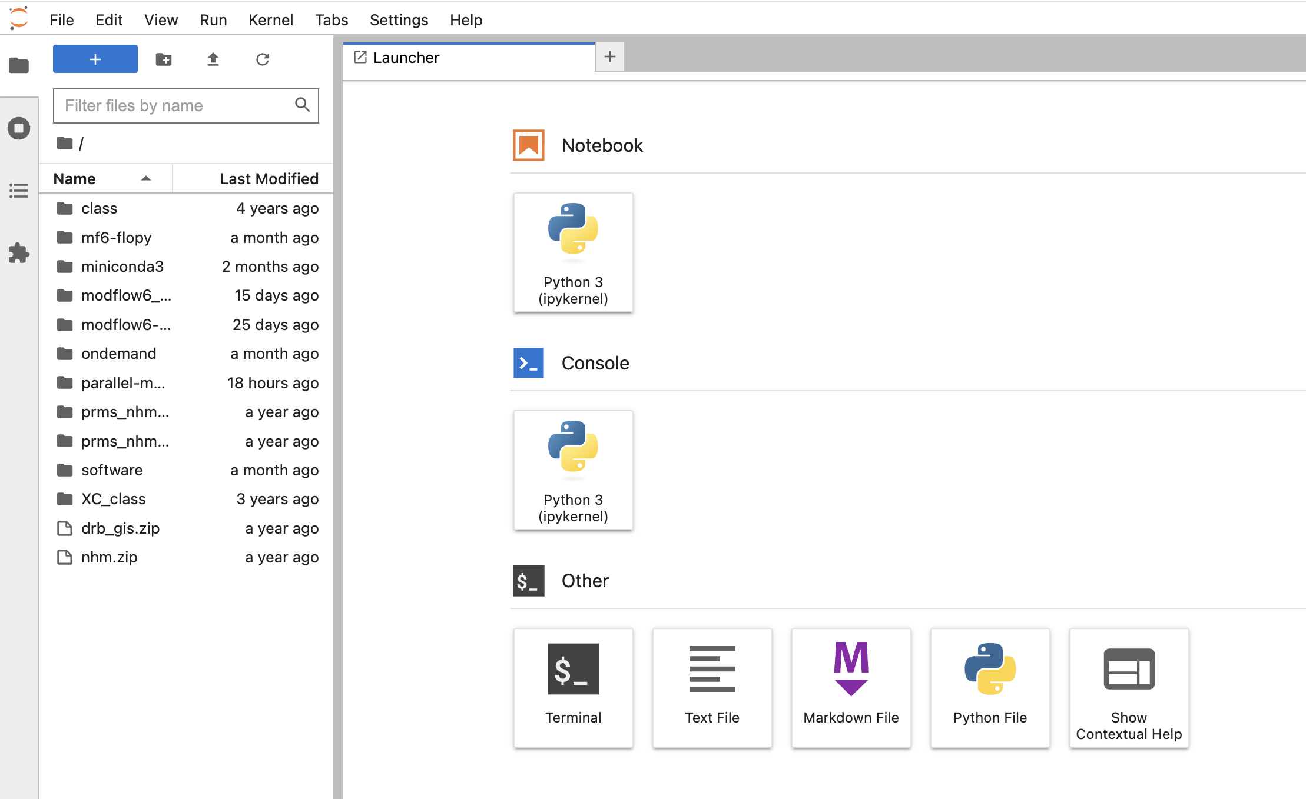
Tallgrass – OnDemand

Slide 10
Tallgrass – OnDemand

